Slide 1
Hosting a Website on your NodeMCU
By,
Prof. Raghudathesh G P

Slide 2
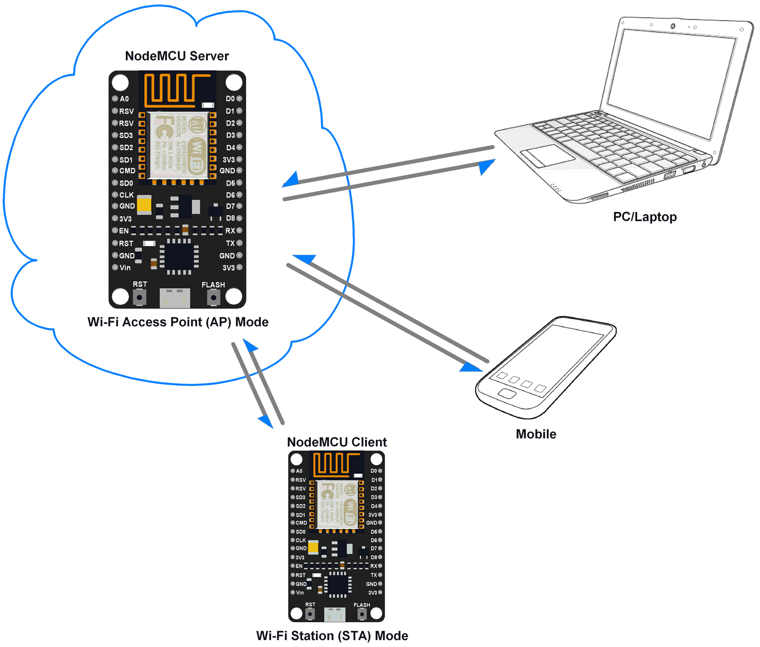
Scenario

Slide 3
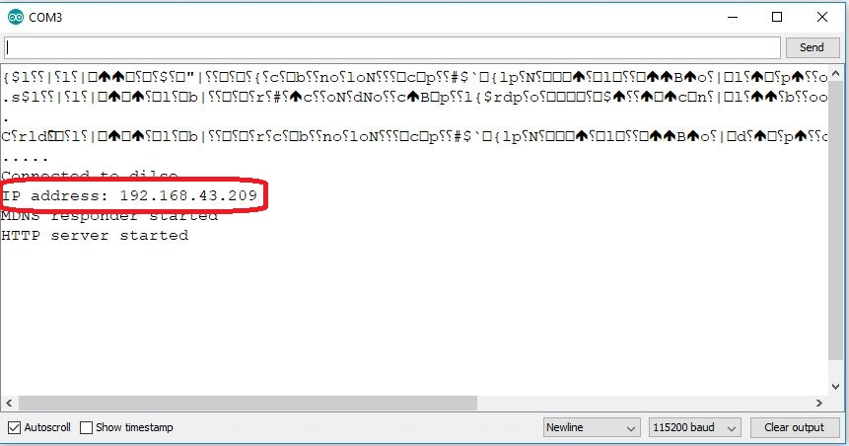

On NodeMCU Side
Open the ino Code Named Nodemcu-HelloServer-plaincode
Enter your ssid, password and upload code to the board.
Open your serial terminal check your Ip address and copy the same.
Past the IP address in your browser and check the output.

Slide 4
Code Changes
In ino Code Named Nodemcu-HelloServer-plaincode introduce a line below password
const char index_html[] PROGMEM = {};
Delete function named handleRoot()
Add a new function module as below
void handleHtml() {
server.send_P(200, "text/html",index_html);
}
In void loop do following changes
server.on("/", handleRoot); → server.on("/", handleHtml);

Slide 5
Getting HTML CSS templates
Paste the following link in your browser
https://www.w3schools.com/w3css/w3css_templates.asp
Select the CV Template for this demo (should work for any template) → Click Demo to view and click try yourself for modification.
Now copy the complete HTML code.
Open a new browser and visit the following link to convert text to c++ string converter.
http://tomeko.net/online_tools/cpp_text_escape.php?lang=en
Paste the HTML code in source text
Uncheck split output into multiple lines and press convert.
Copy the converted text and paste it into const char index_html[] PROGMEM = {--paste code here--};

Slide 6
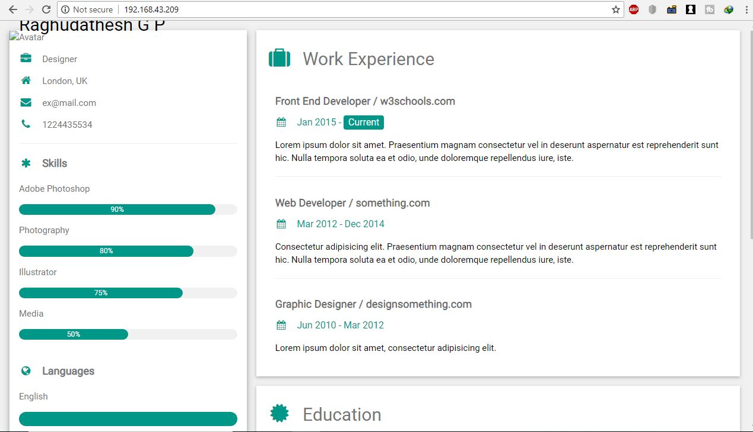
Continue….
Save the file and upload it to the board
Refresh the webpage to see the webpage hosted by nodemcu on your browser.

